Slide 1
Implementing acceleration structures to optimize a sphere tracing ray marcher
Musschoot Adriaan - GD
Samyn Koen - Supervisor
Geeroms Kasper - Coach

Slide 2
Sphere tracing
For each pixel cast ray
March forward along ray
Retrieve the distance value to the scene
Objects represented by SDFs
Small memory footprint

Slide 3
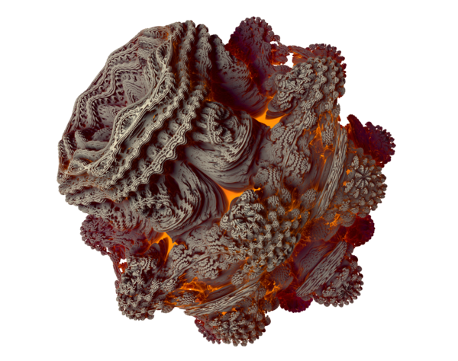
Sphere tracing is slow
Many steps for each ray
Heavy computations complex shapes

Slide 4
Acceleration structures
AABB // early out
BVH-tree

Slide 5
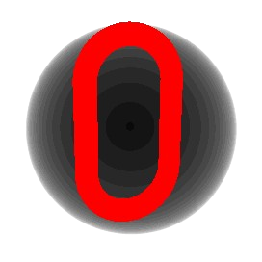

Early out
Sphere
Box

Slide 6

Construction Early Out Sphere

Slide 7

Construction Early Out Box

Slide 8
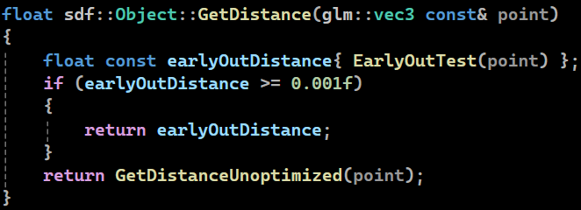
Early out usage

Slide 9

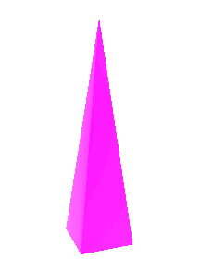
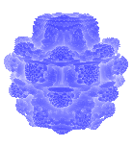
Comparison early out
Object | Link | Pyramid | Mandelbulb
No early out | 0.0108ms | 0.0132ms | 0.0469ms
Sphere early out | 0.0098ms | 0.0143ms | 0.0112ms
Box early out | 0.0094ms | 0.0106ms | 0.0139ms

Slide 10
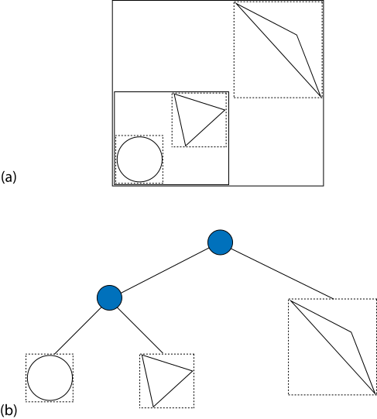
BVH-tree

Slide 11
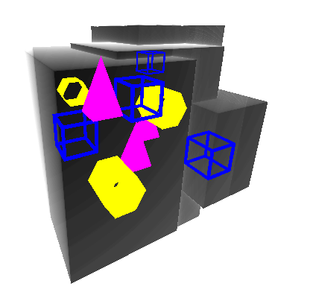
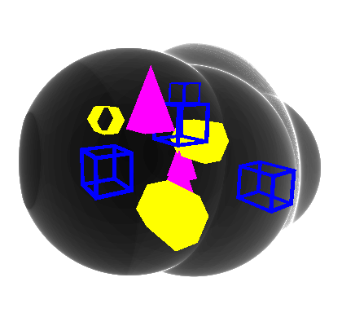
BVH-tree
Sphere
Box

Slide 12
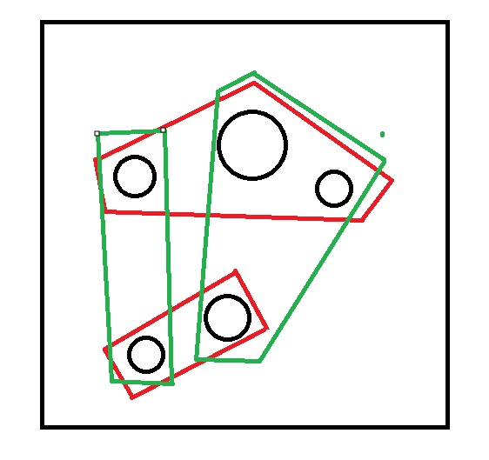
BVH-tree construction
For every node
Origin
Sphere radius / box extent
Surface area heuristic
Repeated until singular object remains

Slide 13
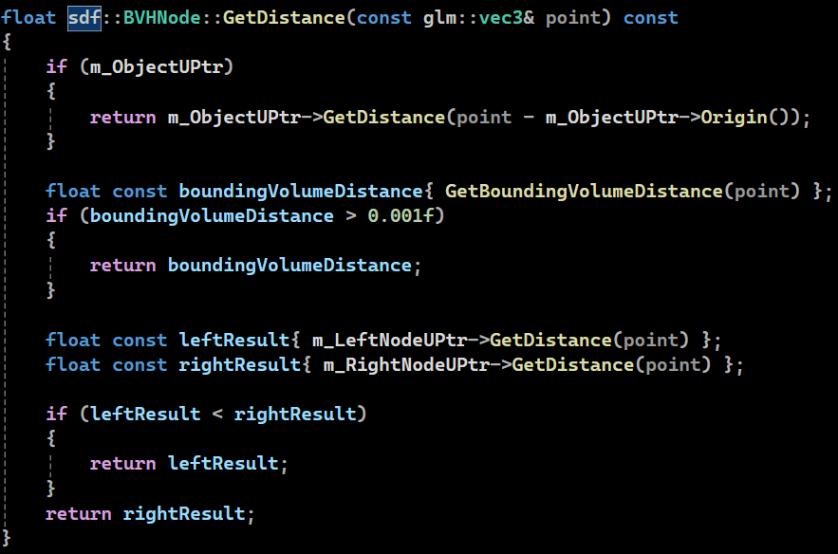
BVH-tree usage

Slide 14
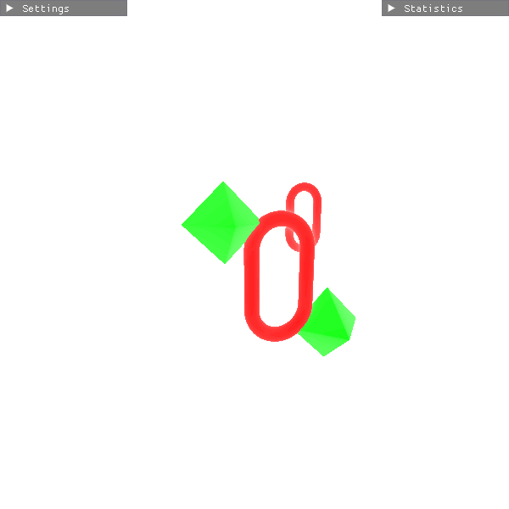
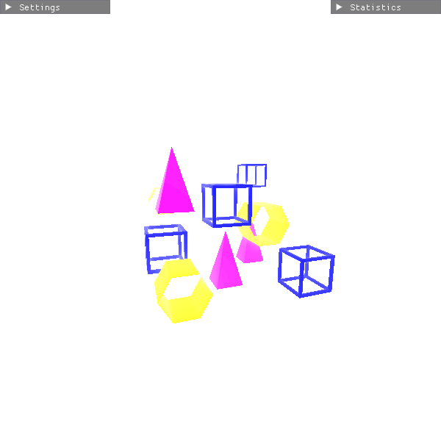
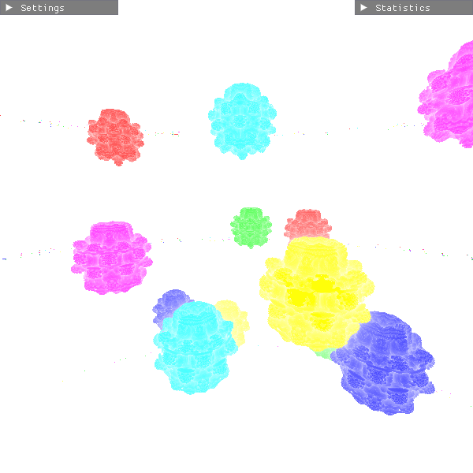
Comparison early out
Scene complexity | Simple | Medium | Complex
No BVH-Tree | 0.0208ms | 0.0232ms | 0.0869ms
Sphere BVH-Tree | 0.0108ms | 0.0143ms | 0.0237ms
Box BVH-Tree | 0.0094ms | 0.0107ms | 0.0211ms

Slide 15
Conclusion
Early out → object dependent
BVH-tree → always faster even in simple scenes
Only tested in static scenarios
Construction and approximation once at the start

